Slide 1
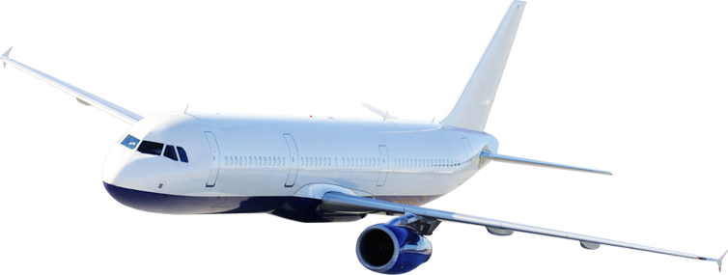

I-Flights Software for Business Aviation

Slide 2
Agenda
Why I-Valley ?
Airlines Success Story
I-Flights Product Overview
Flight Time Limitation Overview
System Users & Rules
Reports
I-Flights Version 2.0
Thanks ☺

Slide 3

1) Why I-Valley …?

Slide 4
Why I-Valley ?
I-valley is software house working in systems development and automation since 2009 with different application types
You Must Trust that I-Valley is the best choice in Aviation Software – But why ?
1- Software Technicality : Our staff are certified with more than 19 certificate from Microsoft Professional Developers network with very strong Software Engineering background
2- Analysis Ability: Our system Architect had a Master degree in Software engineering and business analysis from University of Hull , UK
3- We started from what others reach:
We already did good studies inside the most succeeded Aviation software all over the world like ( LuftHansa and Aims )
- We have 2 pilots working as Business Analyst in our Aviation product.
4- We are the only provider In Middle East:
- No software company provide this service in Middle east except I-Valley

Slide 5





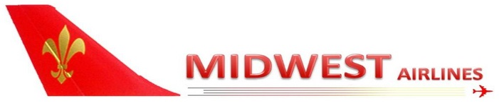



I-Valley Portfolio
We did many success history with the following brands :

Slide 6

2) Airline Success Story

Slide 7
Midwest Airlines success story
- We started our aviation product with Midwest in the end of 2012 .
- We were a replace for Indian system as the company stuff were failed to use the Indian software as it was so complex with many bugs
- We succeeded in fully automate Operation / scheduling , Cabin crew departments and started Training Module.
- Reports comes up from our system were submitted monthly to the Ministry of Aviation ( Pilot hours – Cabin crew hours ).

Slide 8

3) I-Flights Product Overview

Slide 9
Our product overview
Operation / Scheduling
Cabin Crew
Accounting
Sales / Commercial
Sector / Flight
Engineering
Dispatch
catering
Station
Reports
Training

Slide 10
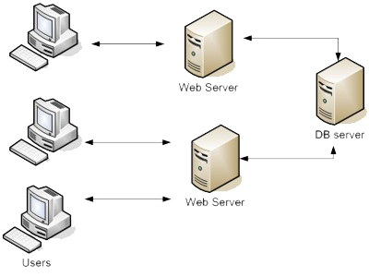
System Architecture
- System will be Central DB solution module with high availability hosting technique as the following architecture :

Slide 11
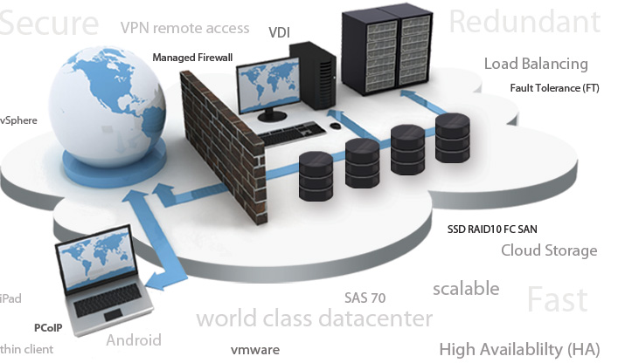
Hosting Model (1)
We provide two different hosting models can match your needs :
1- Totally on cloud hosting model which will cut off the cost of doing local data center

Slide 12
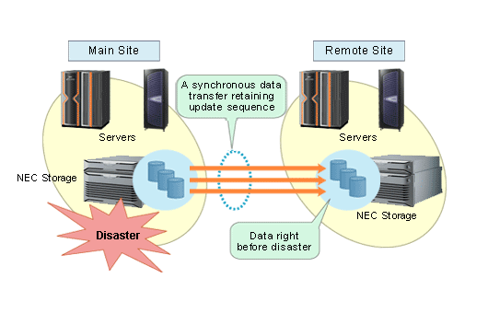
Hosting Model (2)
2- Local hosting on your own datacenter and servers , Also we can publish this solution to the internet to be accessible on both internet and intranet ( Adv and disAdv. )

Slide 13


Data Security
- In our software design we went through the most secure ways to access system data by doing :
* Encryption / Decryption algorithms
* SSL Certificates for data accessibility
* Secure URLs and URL re-writes.
* Multi access levels with security check point with each level.
So with our system your data will be safe .

Slide 14

Backup and Maintenance
* System designed to do daily backup from your system data
* If we have Disaster recovery backup as a separate hardware we can provide backup and replication service for it as well.

Slide 15

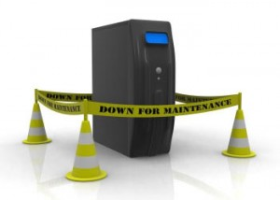
Maintenance and support
* We have periodically check for maintain all data and application servers to try to prevent the usual problems from happening.
* First level support will be our IT repressive who working on your side as he will be well trained to do the first level support .
* Second level support will be at moment support by doing remote session with the unit who has the problem.

Slide 16

4) Flight Time Limitation Overview

Slide 17
Flight time limitation
In operations Manual Chapter 7 it’s take care about all rules working to validate the time limitation for any flight / sector or Pilots
This Chapter is different from country to another , so now we enhancing our system to achieve this layer to be configurable layer .
The following slides will be overview for all rules should be applied to produce succeed schedule.

Slide 18
Flight time limitation
* Accumulative duty and flying hours
(i.e. 50 h/week - 100 h/30 days - 900 h/year) (Implemented on live demo)
Note :
According to Tristarair crew data , we found that Tristarair has only 2 captains. And based on aviation rules , each flight must have at least 1 captain.
This may increase chances to violate accumulative duty flying hour regulations.

Slide 19
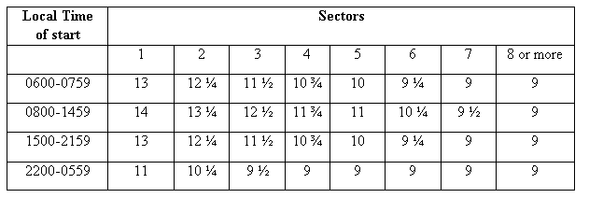
Flight time limitation
Limitation on single flight duty periods (Implemented and in progress to be applied on live demo)
Using below table (or any table supplied according to aviation rules) our system calculate time limitation on single flight
Take off time + Duty Time Limitation – 2 hours (Duty margin)

Slide 20
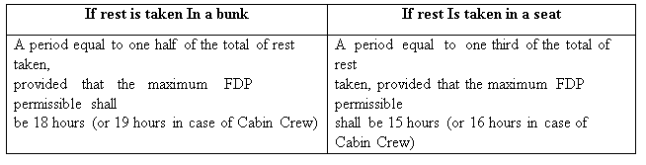
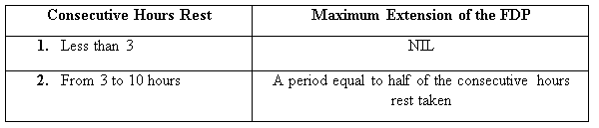
Flight time limitation
* Extending flying duty by (In-flight relief using (bunk - seat)) (Implemented and in progress to be applied on live demo)
* Extending flying duty by split duty (Implemented and in progress to be applied on live demo)

Slide 21
Flight time limitation
* Rest periods (Implemented and in progress to be applied on live demo)
a) Days off (i.e. 1 day off each 7 working days)
b) Rest period outstation / at base

Slide 22

5) System Users & Rules

Slide 23
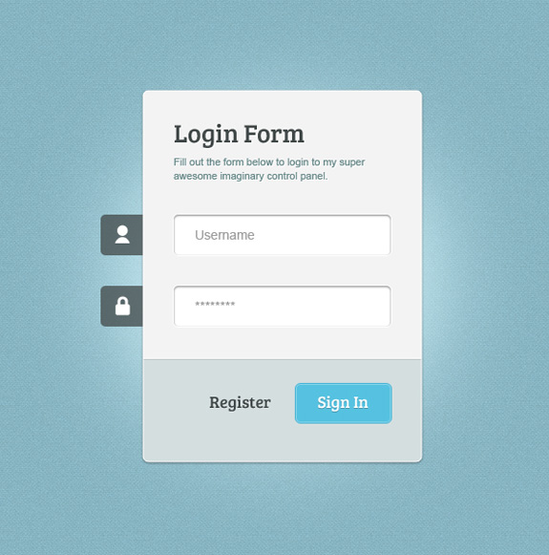

Users Accessibility
- System will be web based application, All users can access it from any where.
- You will not be limited on machines or fixed hardware .
- All Company staff , Pilots, Cabin crew, dispatchers and Top Management will have their own Authentication and Authorization Levels .

Slide 24
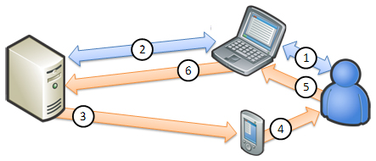
System Usability
- Users can access the system through different devices through the current connection: internet or intranet

Slide 25

6) Business Intelligent Reports

Slide 26
Reporting Services
Reports and Statistics are the most important way to take good decisions in your business
Also this part is customized part – you can ask I-Valley for any new types of Reports needed for your business and it will be developed for free of charge .
In our next version from I-Flights you will be able to design your own reports by your self in our tool

Slide 27
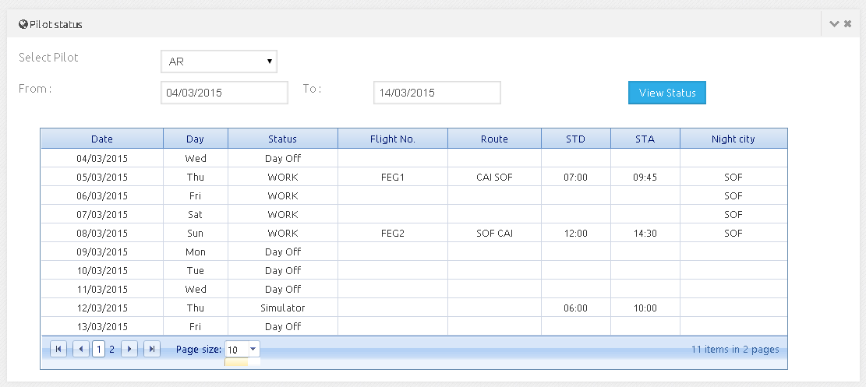

Slide 28
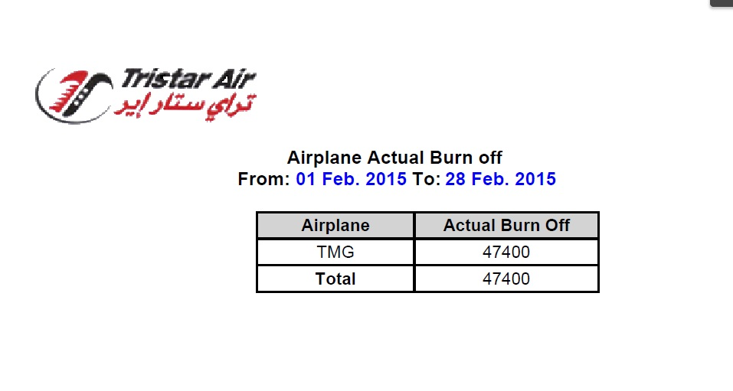

Slide 29
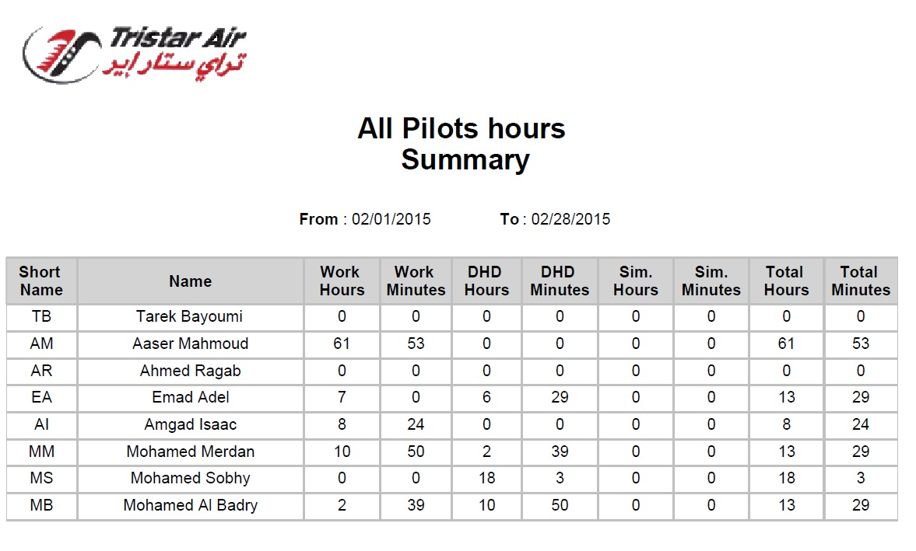

Slide 30
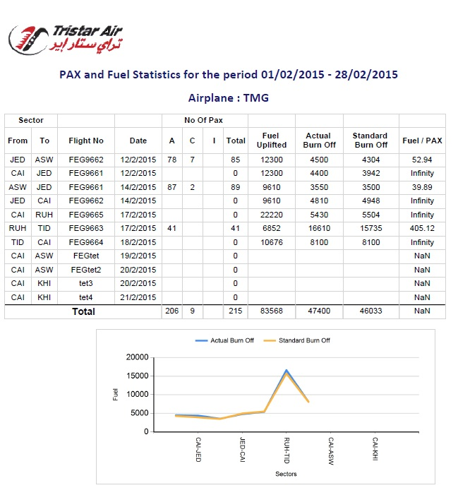

Slide 31
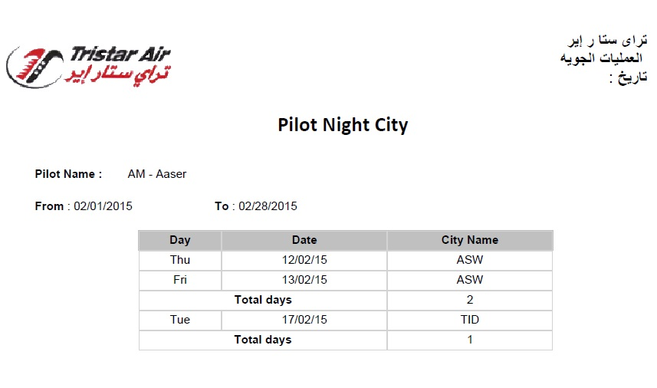

Slide 32
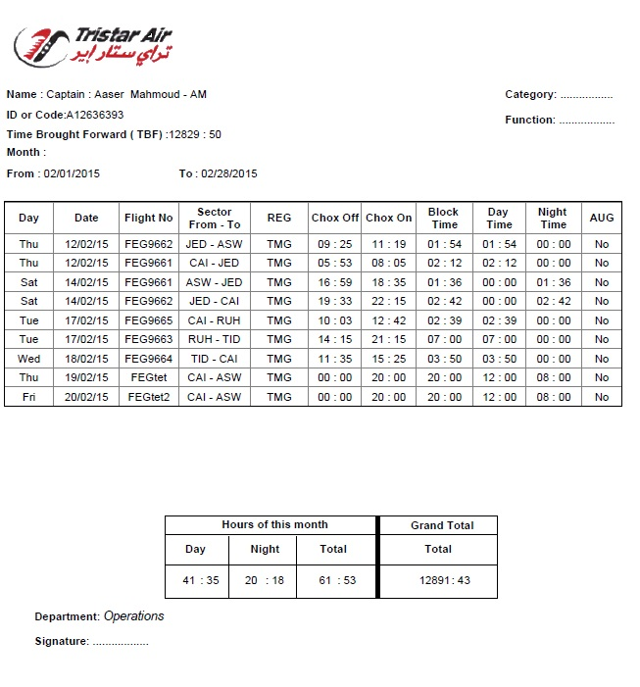

Slide 33
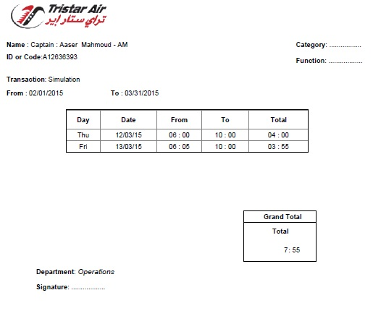

Slide 34
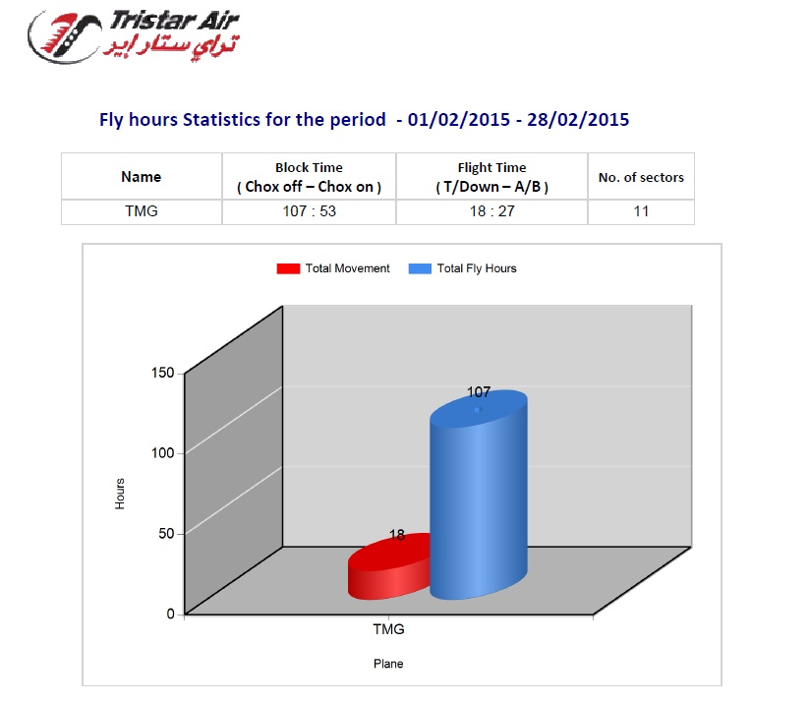

Slide 35
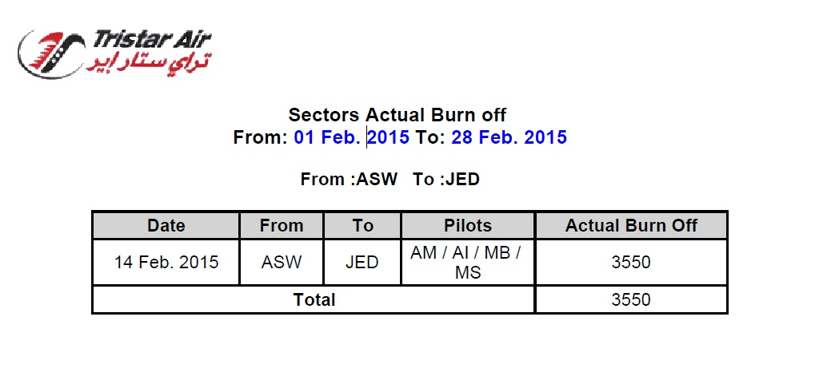

Slide 36

7) I-Flights Upgrades and Next Version

Slide 37
I-Flights Version 2.0
Desktop Software package
All Setting will be 100% configurable
Complete System logging and History
Professional Alerting and notifications module
Business Intelligent Layer ( Data mining – Cubing – Analysis services – Data Prediction – Reports Builder )
Mobile applications and E-Forms implementation
All Airlines modules will be completed
Installing next version in your side will be totally free of charge – just upgrade fees .

Slide 38

8) Thanks and now let’s Demo …

